Slide 1
590 PZ Final Presentation
Sliding Puzzle
Yixin Zhang, Jiaoyuan Li

Slide 2
Agenda
Topic Setting
Brief intro of number slide puzzle
Solving and generating the puzzle
Comparison of BFS and A* search algorithm

Slide 3
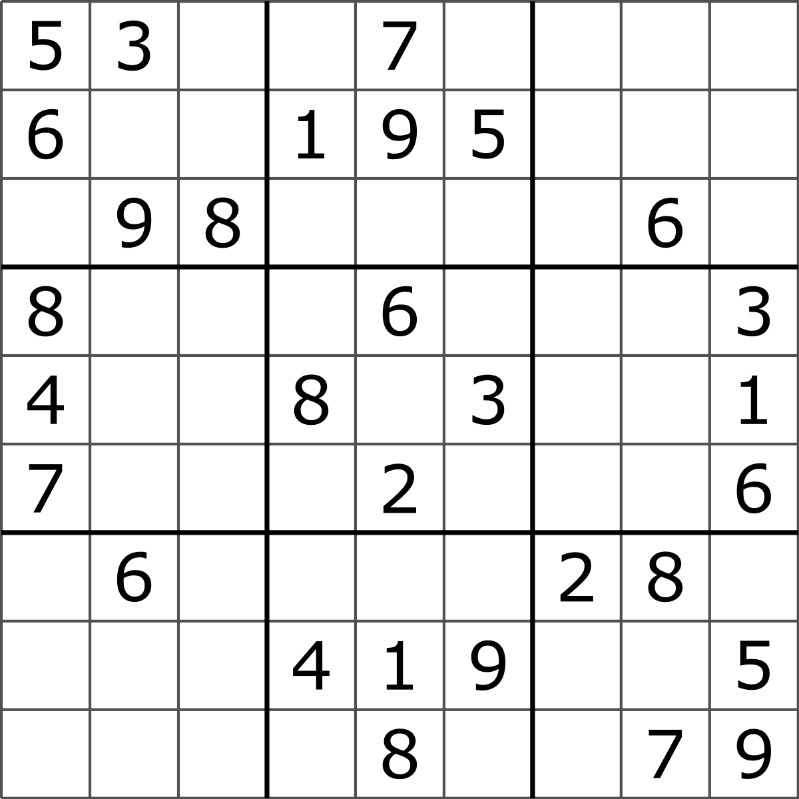
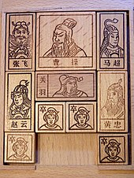
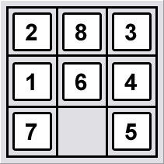
Topic Setting
Topics of our choice:
Sudoku
Too much coding on specific deterministic strategies
Klotski
Numbers of starting state are limited
Numbers of solution are limited
Meaningless effort on changing board size and movable blocks
Number Slide Puzzle
More game states
More flexible on game generating
Notes:
Reference:
Sudoku: https://en.wikipedia.org/wiki/Sudoku
Klotski: https://en.wikipedia.org/wiki/Klotski
Sliding puzzle: https://en.wikipedia.org/wiki/Sliding_puzzle

Slide 4
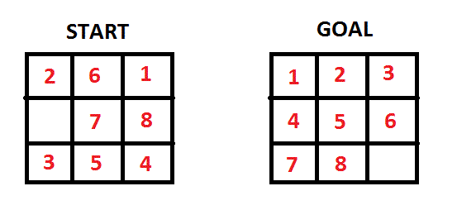
Number slide puzzle
The number slide puzzle consists of a frame of numbered blocks in random order with one block missing.
To solve the puzzle, the numbers need to be rearranged into orders.
In our situation, we are looking for the shortest moving path solution.
Notes:
Reference:
https://en.wikipedia.org/wiki/Sliding_puzzle

Slide 5
Solving and generating the puzzle
Solver
BFS
Starts at the tree root, explore horizontally first, visit all the nodes of current layer before moving on to the next depth level.
Time Complexity: O(Row*Column*(Row*Column )!)
A* search
Start from a specific starting node of a graph, it aims to find a path to the given goal node having the smallest cost.
Maintain a tree of paths originating at the start node and extend those paths one edge at a time until its termination criterion is satisfied.
Time Complexity: O(Row*Column*(Row*Column )!)
An important pruning
According to research, the set of states can be split in half which are exclusive. One could transform to target. The other half must could transform to 1, 2, ..., N-3, N-1, N-2, 0
Notes:
Reference
https://en.wikipedia.org/wiki/Breadth-first_search
https://en.wikipedia.org/wiki/A*_search_algorithm

Slide 6
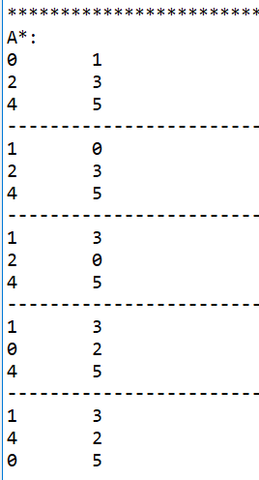
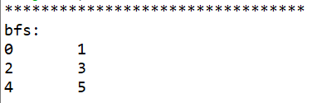
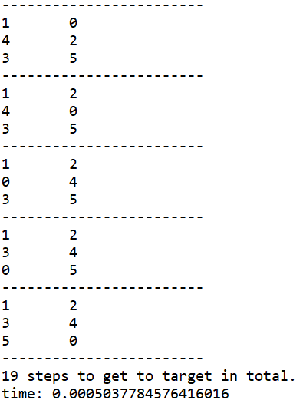
Run the Puzzle!

Slide 7
Solving and generating the puzzle
Solver
A* search
f(n)=g(n)+h(n)
g(n): the cost of the path from the start node to n
h(n): a heuristic function that estimates the cost of the cheapest path from n to the goal
Best answer guaranteed: if h(n) doesn't overestimate the distance to the goal
Apply Manhattan Distance as h(n): d(p, q) = sum(abs(pi - qi)), where pi and qi are the ith element of p and q
Why Manhattan Distance:
For each move, only the number’s column or row index can be changed
Then we need at least counts of the total differences to move to the final state.

Slide 8
Solving and generating the puzzle
Generator
Randomly shuffle the blocks in games board
Applied BFS or A* to check if there is a solution
If yes, return the solution. Save the solution and print out the solution.

Slide 9
Comparison of BFS and A*
Experiment design
Generate the starting game board in different sizes using BFS or A* generator
Collect ten pieces of data for each specific starting game board
Take the average since we have random shuffle when generating game boards
Compare the experiment results
 | 2 x 3 Board | 3 x 3 Board | 3x4 Board
BFS | 10 times | 10 times | 10 times
A* | 10 times | 10 times | 10 times

Slide 10
Thanks!

